Slide 1
NLP and Linguistic Causation:
A Comprehensive Survey

Slide 2
Introduction
Automated knowledge extraction entails development of a model to deal with the interplay of syntax, semantics, a continually evolving vocabulary, and ambiguous constructs like figurative expressions, metaphors, rhetorics, sarcasm and slang
Even a simple task like identifying implicit negations in a sentence remains an unsolved problem.
Automatic extraction of semantic relations has become increasingly important for: question answering, information retrieval, event prediction, generating future scenarios, and decision processing
In particular, cause-effect relation is thought to be very important due to its role in human decision making

Slide 3
2 Broad Categories of Causal Relation Extraction Methods
Linguistics
Approaches that employ linguistic, syntactic and semantic pattern matching only
Statistics and ML
Techniques based on statistical methods and machine learning

Slide 4
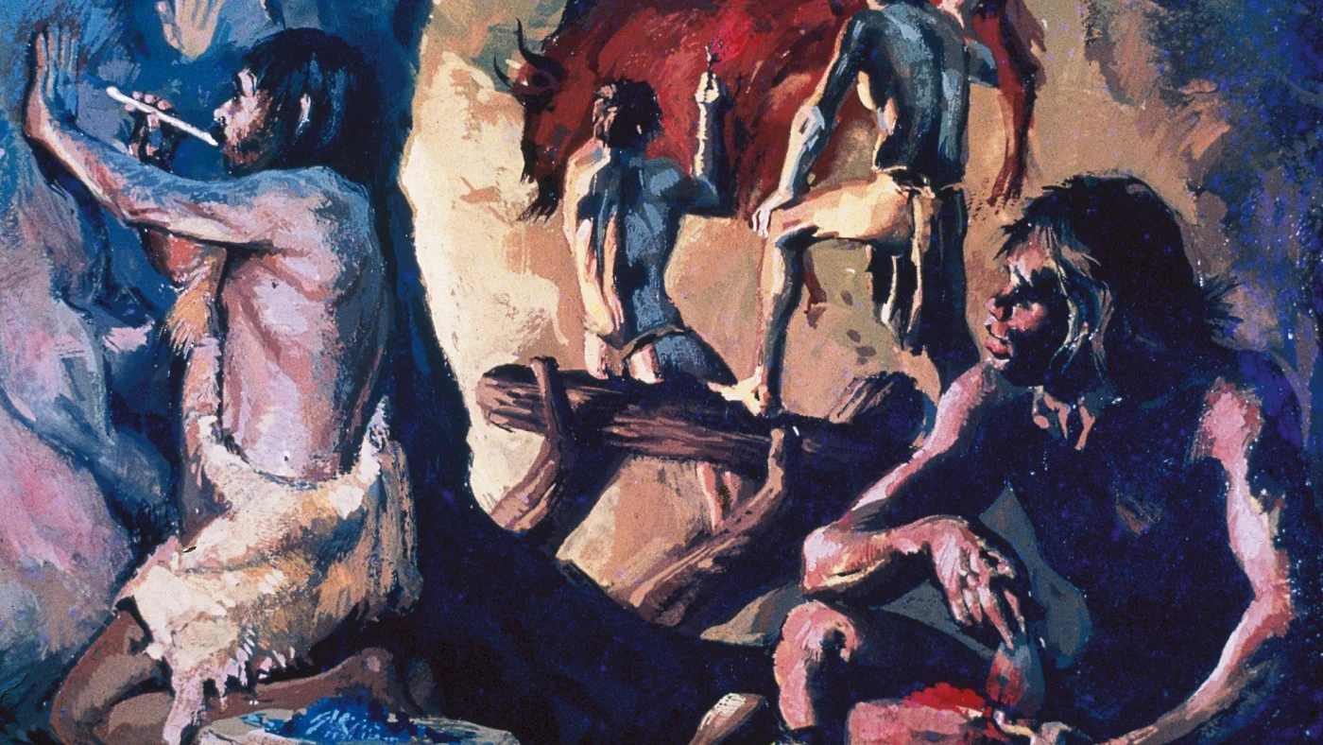
Early Prehistoric Age
Non-Statistical Techniques
1
Causal Analyzers, SEKE, WordNet

Slide 5
Non-Statistical Techniques
1
Causal Analyzers, SEKE, WordNet

Slide 6
Problems
In 1990, current thinking was that a good causal analyzer must necessarily arise from a knowledge representation model that incorporates a semantic framework, and it must simultaneously possess domain knowledge in order to accurately identify meaningful causal relations from any text
One of the earliest tools encoded text into a set of propositions
Propositions → Semantic Analyzer (looks for ‘object’ , ‘action’, ‘relationship’) → Causal Analyzer
Sentence: When a cloud forms the water vapour condenses into water.
Proposition: when(event(form(result(cloud))), event(condense(patient (water vapour), state(water)))
Notes:
Maybe talk about semantics vs syntax

Slide 7
Problems
Causal Analyzer searched for casually related concepts via 4 methods
Using 20 hand-coded explicit propositional clues designating causality, e.g. because, due to and when
Extending the explicit cause-effect pairs found in step 1 to causal chains
Using Doyle’s model of causality to find cause-effect pairs by finding pairs that are both temporally and spatially related
Manually constructing constraints for several domain-specific concepts that may imply causality, e.g. ‘increase(lengthof(axon)) ≡ formation(optic nerve)’. Thus, implicit casualties such as ‘axons lengthening and forms an optic nerve’ are captured by these constraints
This is done by initializing with a seed causal relation X → Y , searching for a causal pair A → B such that B = X, and a causal pair C → D such that Y = C. This produces the chain A → X → Y → D. The process can be repeated to further elongate the chain
Notes:
Maybe talk about semantics vs syntax

Slide 8
Limitations
It requires extensive manual pre-processing, such as encoding the text into propositions, constructing propositional clues to detect explicit causal relations and designing constraints to detect implicit casualties.
Moreover, these steps are predominantly domain specific; expert knowledge is required to design a handful of clues and constraints manually.
In addition, it is not clear how the temporally and spatially related concepts are extracted in step 3.
The data set is tiny, comprising at most a hundred expository sentences. Thus, narrative and episodic texts are ignored, as are ambiguous syntactic and semantic constructs like analogies, references and ellipses.

Slide 9
Achieving Domain-Independence
Classifications of explicit representations (Khoo et al.):
1) Causal links can be used to link clauses or sentences. e.g. so, hence, therefore ; because of, on account of ; because, as, since ; that’s why, the result was
2) Causative verbs are transitive verbs whose meanings include a causal element. Examples
include break and kill, whose transitive forms are to cause to break and to cause to die.
3) Resultative constructions are sentences in which the object of a verb is followed by a phrase
describing the state of the object as a result of the action denoted by the verb. E.g, ‘It stained
the cell green’ and ‘The molecule activated the cell to a growth-state’
4) If-Then conditionals often indicate that the antecedent causes the consequent.
5) Causation adverbs and adjectives have causal element in their meanings, e.g. fatal or fatally,
that can be paraphrased as to cause to die
Notes:
Would be nice if texts simply said A causes B or B is caused by A but because there is a lot of controversy among domain experts whether one causes something or another, people use a lot of different representations to imply causality

Slide 10
Problems
The algorithm was evaluated on Wall Street Journal articles spanning four months, containing a total of 1082 sentences, and was compared to the list of causal relations identified and agreed upon by two human judges. For causal links the recall was 78% and the precision was 42%, whereas for causative verbs the recall was 61% and precision was 19%.
Overwhelmingly poor precision attributed to lexical ambiguities. For instance, the algorithm did not take into account the fact that the same syntactic constructions used to indicate cause-effect can also be used to indicate other types of relations.
Several mistakes were made due to complex sentence structures, and a few omissions occured because some causative verbs (e.g. lift) occured in the text in a noun form, a non-trivial check that the algorithm failed to consider.

Slide 11
Problems
Overall, most of the limitations of Khoo’s work could be attributed to the use of explicit causal indicators only and ignoring implicit causalities. Moreover, the absence of inferencing from a knowledge-base and the use of a domain independent data set led to many lexical ambiguities.
It is clear that the syntax of each of these representations can vary, and these variations are difficult to capture and formalize using a single grammatical model.
In fact, other studies propose entirely different classifications of syntactical representations of causal relations, each with its own merits and de-merits.
Moreover, these classifications are not generalizable to non-English languages such as Chinese, Arabic, and French.

Slide 12
A Jump Forward
In 2002, an algorithm for automatic discovery of linguistic patterns expressing causal relations and a semi-supervised way to validate the list of obtained patterns based on semantic constraints on nouns and verbs.
To simplify the problem, the authors focused on explicit syntactic patterns of the form NP1-SimpleCausativeVerb-NP2
Simple Causative Verb – verbs that are synonymous with ‘to cause’
Used WordNet to determine simple causative verbs.
Concretely, the algorithm extracts all possible pairs of noun phrases between which WordNet causal relations exist, and then for each pair NP1-NP2 found, it searches a collection of documents to find all the patterns of the form NP1-Verb/VerbExpression-NP2.
This procedure outputs a list of verbs or verb expression that refer to causation most of the times, but not always.

Slide 13
Ranking Causality
Semantic constraints on a verb are found by ranking the verb’s senses based on frequency and ambiguity
Based on these constraints, the pattern is ranked on a scale of 1 to 4, with 1 denoting a highly likely causal relation and 4 denoting high ambiguity
The reliance of Girju and Moldovan’s work on WordNet was an excellent attempt at handling implicit and ambiguous cases, and the ranking procedure was very useful and novel.
However, there were some obvious limitations, in that they only considered explicit causal syntactic patterns of a particular form, and focused on extracting explicit and simple causative verbs only.

Slide 14
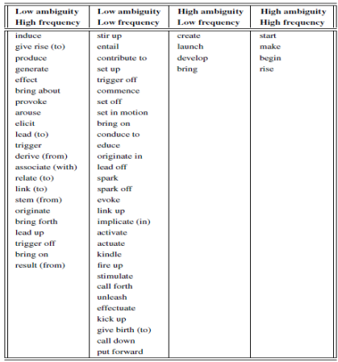
Ranking of Ambigous Causation Verbs
Notes:
Would be nice if texts simply said A causes B or B is caused by A but because there is a lot of controversy among domain experts whether one causes something or another, people use a lot of different representations to imply causality

Slide 15
Using Expectations
Early 2000s, novel idea was that humans understand and extract knowledge from texts easily because they have some expected semantics for the text in mind, which guides their search and understanding of information in the text
For example, the expectations about the text while reading a newspaper are different from those while reading a story book or a novel
Therefore, expectation-based semantics should be used to build a generic and domain independent causal searching tool
Developed SEKE, a Semantic Expectation-based Knowledge Extraction framework for causal relations

Slide 16
Semantic Expectation-Based Knowledge Extraction
As a preprocessing step, the templates are designed manually by picking out and semantically analyzing all the sentences containing causative expressions from a training corpus (in this case, 365 news articles about Hong Kong stock market).
Thus, templates for simple and complex sentences are designed first, and then the templates for causes and effects are designed.
SEKE then processes the text by screening out all the non-causative sentences in the test data using the sentence template, and parsing the remaining sentences into causes and effects through pattern matching using the reasons and consequences templates
To account for complex sentences, the extracted causes and effects are recursively parsed to obtain deeper or implicit causal knowledge from them
SEKE includes a WordNet-based component, used for finding concepts synonymous to the extracted case and effect phrases
Notes:
Word-Net component helps with disambiguation and also generates new causal patterns that are previously unseen.
Essentially pattern-matching

Slide 17
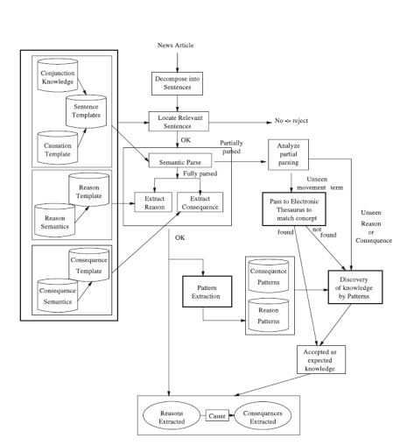
Semantic Expectation-Based Knowledge Extraction Framework
Notes:
Would be nice if texts simply said A causes B or B is caused by A but because there is a lot of controversy among domain experts whether one causes something or another, people use a lot of different representations to imply causality

Slide 18
Semantic Expectation-Based Knowledge Extraction
The authors tested SEKE’s performance on a test set of 365 Hong Kong stock market related news articles, and obtained a recall of 45.9% and a precision of 71.6%
More importantly, SEKE found several unseen patterns successfully. Thus, the authors successfully augmented Girju and Moldovan’s idea of using WordNet and pattern ranking to handle ambiguities and to generate previously unknown knowledge.
The results of the techniques discussed so far established the existence of a trade-off between high accuracy (high precision and high recall) and scalability to multiple domains.
Predominantly, no one paid much attention to the extraction of implicit causal patterns that have no specific linguistic form, i.e. they are not synonymous with to cause but still influence the reader to causally link two or more events in the text.
Notes:
Word-Net component helps with disambiguation and also generates new causal patterns that are previously unseen.

Slide 19
Handling Implicit Relations
Around 2008, implicit relations was attempted to be tackled using three types of implicit causal relations
Also found way to disambiguate polysemous patterns by using Wikipedia to build a knowledge base
1. resultative and instrumentative verbal patterns e.g. increase, kill which specify the resulting situation
2. patterns that make the causal agents inseparable from the resulting situations, e.g. white spots mar the X-ray image
3. non-verb patterns, e.g. due to
Notes:
Word-Net component helps with disambiguation and also generates new causal patterns that are previously unseen.

Slide 20
Building Implicit Relations Understanding
First, all the shortest patterns linking two noun phrases are extracted. To algorithm starts with a seed causal pair (e.g. hiv - aids) and identifies patterns in Wikipedia that connect the seed pair
These steps are repeated iteratively for as many seed pairs as desired. This procedure of learning new patterns from pairs and vice versa is carried out till a suitable number of causal relations has been extracted
To evaluate the algorithm, the authors initialized it with a domain specific Wikipedia dump consisting of ∼ 500 million words. From the 2 million generic patterns extracted, the algorithm used 20 seed pairs to identify 81 causal patterns.
On a test set of 32,545 domain specific documents, a precision of 0.765 and a recall of 0.82 was obtained.
Evidently, these results are as good as the state-of-the-art discussed previously, with the added merit of handling implicit relations in a relatively effective way
Notes:
Word-Net component helps with disambiguation and also generates new causal patterns that are previously unseen.

Slide 21
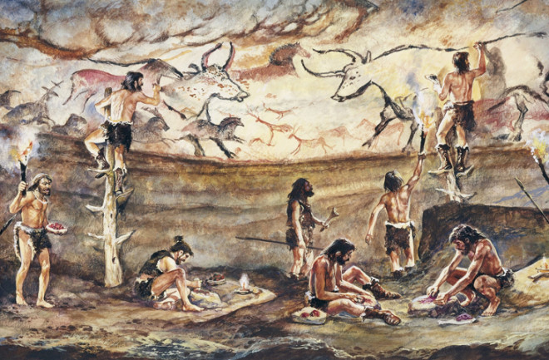
Late Prehistoric Age
Statistical and Shallow ML Techniques
2
Regression, Naïve-Bayes, Decision Trees

Slide 22
Statistical and Shallow ML Techniques
2
Regression, Naïve-Bayes, Decision Trees

Slide 23
Decision Trees
Previous method used semi-supervised pattern validation and ranking procedure, consisting of identification of semantic constraints on each causal pattern and pattern ranking.
Newer method in 2003 uses a supervised method that utilizes C4.5 decision trees.
Training corpus of 6000 sentences and test corpus of 1200 sentences containing each of the 60 simple causative verbs was created using a domain-independent text collection.
Using a syntactic parser, 6523 relations of the form NP1-Verb-NP2 were found, from which 2101 were causal relations and 4422 were not. These were the positive and negative examples used to train the decision-tree classifier.
Notes:
Word-Net component helps with disambiguation and also generates new causal patterns that are previously unseen.

Slide 24
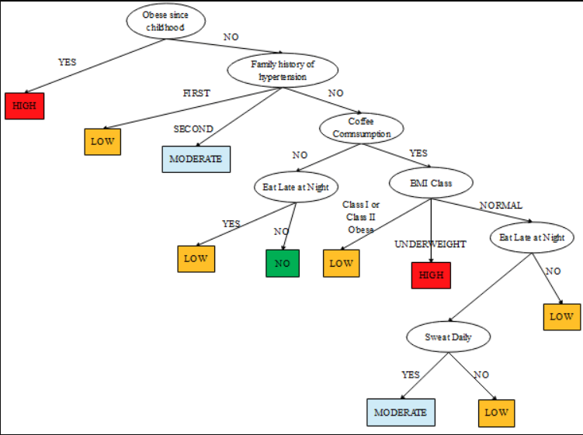
Decision Tree formulated using C4.5 for Risk of Kidney Stones
Notes:
Would be nice if texts simply said A causes B or B is caused by A but because there is a lot of controversy among domain experts whether one causes something or another, people use a lot of different representations to imply causality

Slide 25
Decision Trees
As features, the constraints on the nouns and verb, which were necessary for a pattern to be a causal relation, were identified.
In particular, for each value of NP1 (and similarly for each NP2), nine noun hierarchies from WordNet were used as semantic features: entity, psychological feature, abstraction, state, event, act, group, possession and phenomenon.
The training process produced several constraints, which were ranked based on frequency and accuracy. The model obtained a precision and recall of 73.91% and 88.69% respectively on the test set.
These numbers indicate that this machine learning variant of Girju and Moldovan’s work was much more effective, and most of the errors arose from the simplification assumptions, e.g. disambiguating a relation based on a restricted list of 60 causative verbs only
Notes:
Word-Net component helps with disambiguation and also generates new causal patterns that are previously unseen.

Slide 26
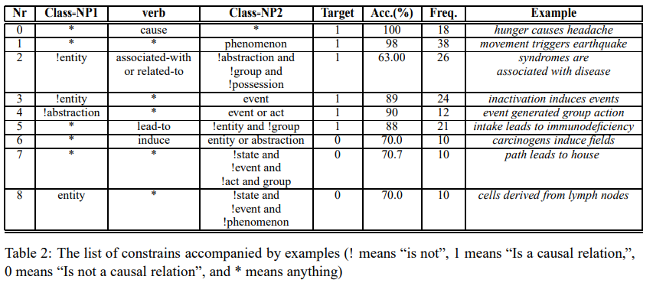
Rules Learned by the Decision Tree
Notes:
Image 1: You can see the type of rules the decision tree learned to determine if the class-NP1 and class-NP2 were related through cause and effect. For example, for Rule 0, if the verb linking them is “cause” then there is a 100% chance it’s a cause-effect relationship. Or for Rule 3, if NP1 is not an entity and NP2 is an event there is an 89% chance it’s cause-effect.

Slide 27
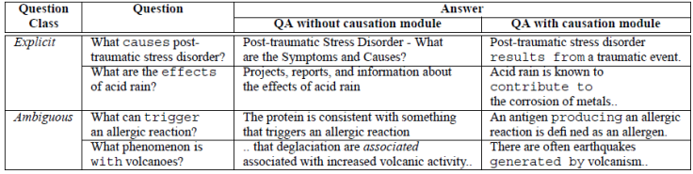
Q&A Answering System using generated causation model from decision tree
What molecules result in optic nerve regeneration for mice in vivo?
For mice, zymosan and oncomodulin result in optic nerve regeneration in vivo.

Slide 28
Automating Finding Causative Sentences
Creating large causally-labelled datasets for supervised machine learning was one way to solve the problem encountered by Girju, but it would be very time and effort consuming.
A year later, Chang and Choi a workaround mechanism to learn cue phrase and lexical pair probabilities from raw and domain-independent corpus in an unsupervised manner, and use these to extract inter-noun and inter-sentence causalities
A cue phrase is a word, phrase or a word pattern that connects one event to another with some relation. The 60 simple causatives found by Girju are examples of causal cue phrases.
The lexical pair bacteria-disease is a causal lexical pair.
Notes:
Word-Net component helps with disambiguation and also generates new causal patterns that are previously unseen.

Slide 29
Naïve Bayes Classifier
In 2004, Chang and Choi used a Connexor dependency parser to extract ternary expressions of the form NP1-CuePhrase-NP2, where NP1 and NP2 together form the lexical pair.
These ternaries are filtered with a set of pre-defined cue phrases based on the 60 causal verbs.
An initial classifier based on cue phrase confidence scores, i.e. the probability of the causal class given a cue phrase, is used to extract highly ranked ternaries, which are treated as the initial causality annotated training set for a Naive Bayes classifier
The Naive Bayes classifier’s task is to classify each ternary expression as either causal or non-causal using the cue phrase and the lexical pair as the independent features for each training sample
These probabilities and other parameters are learned and improved using an iterative Expectation-Maximization procedure, instead of relying on a large annotated data set.
Notes:
Word-Net component helps with disambiguation and also generates new causal patterns that are previously unseen.

Slide 30
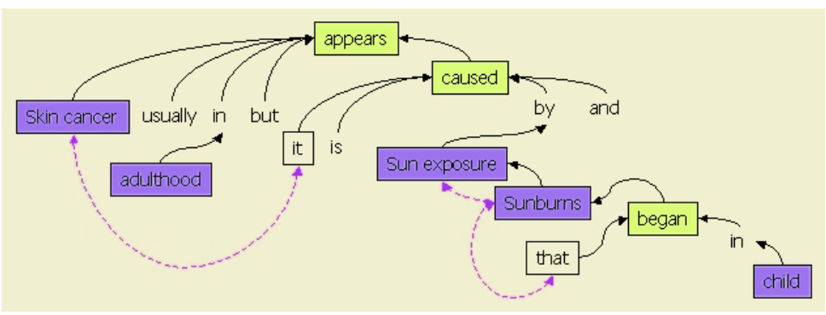
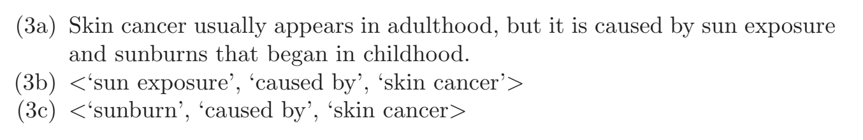
Naïve Bayes Classifier
Notes:
Would be nice if texts simply said A causes B or B is caused by A but because there is a lot of controversy among domain experts whether one causes something or another, people use a lot of different representations to imply causality

Slide 31
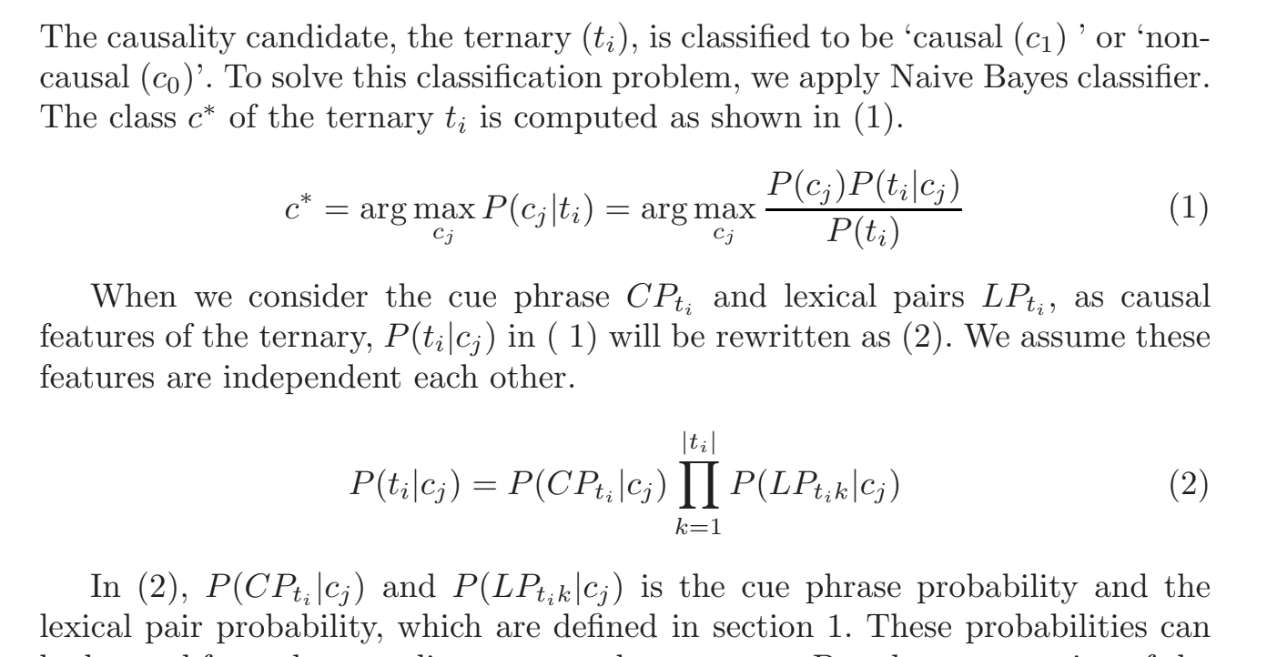
Naïve Bayes Classifier
Notes:
Would be nice if texts simply said A causes B or B is caused by A but because there is a lot of controversy among domain experts whether one causes something or another, people use a lot of different representations to imply causality

Slide 32
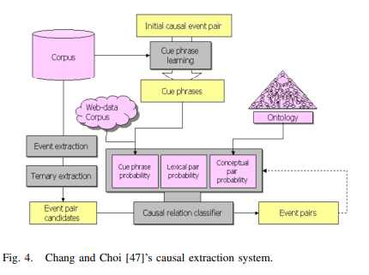
Chang and Choi’s Causal Extraction System using a Naïve Bayes Classifier
Using an unlabeled domain-independent raw corpus consisting of 5 million sentences as the training set, and two manually annotated test sets, the best results achieved by this model had a precision of 81.29%.
Notes:
Would be nice if texts simply said A causes B or B is caused by A but because there is a lot of controversy among domain experts whether one causes something or another, people use a lot of different representations to imply causality

Slide 33
Problems with Chang and Choi’s Classifier
Chang and Choi’s work was an effective demonstration of how to extract causal relations based on statistical models using a very large unlabelled data set, but their evaluation results and error analysis left a little something to be desired.
They did not quote the model’s recall or F-score, indicating that they focused on improving the model precision only, which is not always a good idea.
They also did not justify the use of the Naive Bayes classifier, which over-simplifies the relationship between different features.
Furthermore, the ternary causation pattern used was the same as previous works; so were the cue phrases (simple causative verbs only).
Notes:
Word-Net component helps with disambiguation and also generates new causal patterns that are previously unseen.

Slide 34
Further Advancements
The year 1998 saw the birth of a forum called SensEval (renamed to SemEval in 2007) for the evaluation of approaches to the semantic analysis tasks in NLP.
One of the tasks in SemEval was the classification of seven frequently occurring semantic relations between nouns or noun phrases: Cause-Effect, Instrument-Agency, Product-Producer, Origin-Entity, Theme-Tool, Part-Whole and Content-Container.
The best system was by a team who used a combination of lexical, syntactic and semantic features over a training set that contained explicit and market causal relations only, and used Support Vector Machines (SVMs) to correctly classify the cause-effect relations with F-measure of 0.82 and accuracy of 0.775.
In 2010 a team obtained a precision and recall of 0.89 using WordNet and POS-tagging based dependency relations to train decision trees on the SemEval 2010 datasets, and achieved an F-score of 0.858.
Notes:
Note that the problem of multi-way classification of semantic relations is different from the problem of causal relation extraction. However, one could possibly use a semantic relations classifier for disambiguation during causal relation extraction.

Slide 35
PREPOST
In 2010, idea came to extract common-sense knowledge from text by mining pre and post-conditions of actions and events from Web text.
For any action word A, PREPOST uses a search engine to collect a large set of documents D_{A} that contain A in the pattern ‘is/are/was/were A-ing’.
From D_{A}, a list of possible pre- and post-condition words is created by computing the pointwise mutual information (PMI) between A and every word in D_{A} and taking the top 500 words as the candidate pre- and post-conditions.
The PMI score encodes the degree of association between the action word and every candidate word.
Using this feature, the classifier can determine that ‘liquid’ is a more likely post-condition for ‘melt’ than ‘gas’, because it is more highly correlated with the former in text.
Notes:
Note that the problem of multi-way classification of semantic relations is different from the problem of causal relation extraction. However, one could possibly use a semantic relations classifier for disambiguation during causal relation extraction.

Slide 36
PREPOST
Furthermore, to sieve out highly correlated words that are not pre- or post-conditions of the action, PREPOST determines the 3000 most frequently occurring words from the entire corpus.
It then computes χ² between each candidate feature word and the labeled pre- and post-conditions, and keeping the top 161 feature words corresponding to high values of χ^{2.}
The learning is done using SVMs with the radial basis function (RBF) kernel.
Using 5 action words for training and 35 action words for testing, PREPOST achieved a precision and recall of 0.943 and 0.854 respectively for pre-conditions, with similar values for post-conditions.
Notes:
Note that the problem of multi-way classification of semantic relations is different from the problem of causal relation extraction. However, one could possibly use a semantic relations classifier for disambiguation during causal relation extraction.

Slide 37
PREPOST Advantages
PREPOST only uses a small set of labeled data for learning and generalizes remarkably well to unseen actions and events with high precision and recall.
Thus, it is an effective model of how the world changes over time.
It also captures pre-conditions relationships, which are not directly captured by any of the previously discussed techniques.
Furthermore, techniques mentioned so far cannot distinguished between event-event relationships (rain causes flooding) and event-state relationships (rain causes wet grass). PREPOST focuses on the latter type of relations only.
The PMI statistic has been used in a lot of other NLP models as it allows us to quantify the likelihood of co-occurrence of two words, taking into account frequency of each of the individual words occurring on their own.
Notes:
Note that the problem of multi-way classification of semantic relations is different from the problem of causal relation extraction. However, one could possibly use a semantic relations classifier for disambiguation during causal relation extraction.

Slide 38
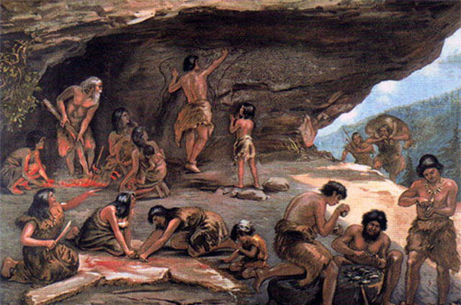
Stone Age
Simple Neural Networks
3
Word Embeddings, Word2Vec

Slide 39
Simple Neural Networks
3
Word Embeddings, Word2Vec

Slide 40
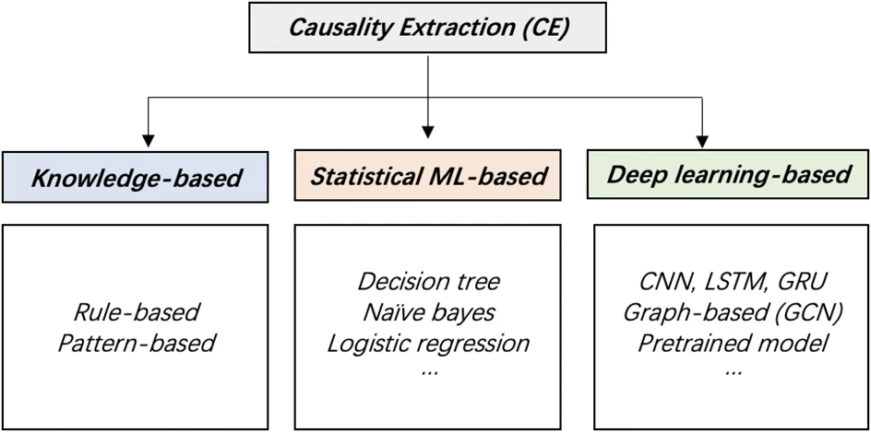

Slide 41
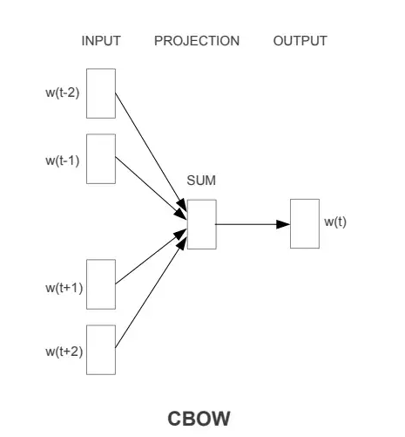
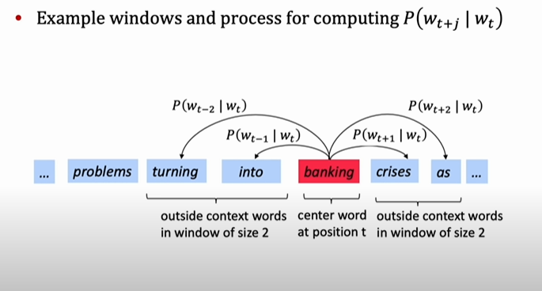
Word Embeddings
In 2013, Mikolov et al. came up with idea of a word’s meaning being given by the words that frequently appear close-by
When a word w appears in a text, its context is the set of words that appear nearby (within a fixed-size window)
Model works by iteratively adjusting the vector representation of a word to maximize the probability of predicting the center word from its context
“hydraulic”
[-.15, -.85, 1.25, … x 200]

Slide 42
Word Embeddings
https://projector.tensorflow.org/

Slide 43
Deep Neural Networks
The advantages of using word embeddings is that it turns text into a numerical form that deep neural networks can understand.
Furthermore, they densely represent words and replace the sparse vectors that were previously used to represent words
Neural Networks do much better with dense feature vectors rather than sparse vectors such as one-hot encodings that were previously used to represent words
This spawned the explosion of deep learning neural networks in 2018 that progressed NLP and linguistic causation including: CNNs, RNNs, LSTM, BERT, ELMO, and GPT-3
Notes:
Note that the problem of multi-way classification of semantic relations is different from the problem of causal relation extraction. However, one could possibly use a semantic relations classifier for disambiguation during causal relation extraction.

Slide 44
Convolutional Neural Networks
Convolutional Neural Network (CNN) with pre-trained word embeddings, achieved state-of-art performance for SemEval-2010 task 8 challenge (Nguyen, Grishman, 2015, Santos, Xiang, & Zhou, 2015, Zeng, Liu, Lai, Zhou, Zhao, 2014).
The pre-trained word embeddings encode semantic and syntactic information of words into fixed-length vectors and CNN is able to extract meaningful n-grams from sentences
Compared with rule-based methods and rich features-based methods, the CNN models with word embeddings are able to extract complex causal relations more effectively.
However, these models rely on large amount of training data which should cover all the causal relation expressions in natural language.
This is impractical due to the variety and ambiguity of words and sentences in natural language. With a large number of free parameters in deep learning models, the models can easily over-fit the limited and biased training data, and thus hinder the performance of deep learning models.
Notes:
https://www.sciencedirect.com/science/article/abs/pii/S0957417418305177

Slide 45
Recurrent Neural Networks
An RNNs is essentially a fully connected neural network that contains a refactoring of some of its layers into a loop.
RNNs effectively have an internal memory that allows the previous inputs to affect the subsequent predictions. It’s much easier to predict the next word in a sentence with more accuracy, if you know what the previous words were.
3 Advantages
They can process inputs of any length. This is in contrast to other networks such as CNNs that can process only fixed-length inputs. As a result, we can use RNNs with sequences that are short as well as very long without changing our network’s architecture.
The hidden state acts like some type of memory. As the network processes the elements of a sequence one by one, the hidden state stores and combines the information on the whole sequence.
Finally, the third advantage of RNNs is that they share the weights across time steps. This allows the network to stay the same size (with the same number of parameters) for sequences of varying lengths.
Notes:
https://aclanthology.org/W18-5035.pdf

Slide 46
Recurrent Neural Networks
4 Disadvantages
Due to their sequential nature, they can be slow to train. In other words, as the input to one step of the networks comes from the previous step, it is difficult to perform the steps in parallel to make the training faster.
RNNs have a problem called vanishing or exploding gradients. The former problem occurs when multiplying many gradients less than one. The result is a near-zero value, so it doesn’t contribute to the weights update. The latter happens when we multiply many gradients larger than one, so the result explodes
Vanilla RNNs can have difficulty processing the long-term dependencies in sequences. Long-term dependencies may happen when we have a long sequence. If two complementary elements in the sequence are far from each other, it can be hard for the network to realize they’re connected. For instance, let’s consider this sequence
Also RNNs are capable of capturing the dependencies in only one direction of language. So it assumes that the word coming after has no effect on the meaning of the word coming before.
Notes:
Programming is a lot of fun and exciting especially when you’re interested in teaching machines what to do. I’ve seen many people from five-year-olds to ninety-year-olds learn it.
Here, the word it at the end of the sentence refers to programming which is the first word. In between, there are many other words, which could cause an RNN to miss the connection. This happens even though RNNs have some type of memory. However, the LSTMs can resolve this issue.

Slide 47
LSTM
LSTM stands for Long-Short Term Memory. LSTM is a type of recurrent neural network but is better than traditional recurrent neural networks in terms of memory.
It does so by using 3 main gates
FORGET gate - responsible for deciding which information is kept for calculating the cell state and which is not relevant and can be discarded.
INPUT gate - updates the cell state and decides which information is important and which is not. As forget gate helps to discard the information, the input gate helps to find out important information and store certain data in the memory that relevant.
Cell state - All the information gained is then used to calculate the new cell state. The cell state is first multiplied with the output of the forget gate. This has a possibility of dropping values in the cell state if it gets multiplied by values near 0. Then a pointwise addition with the output from the input gate updates the cell state to new values that the neural network finds relevant.
OUTPUT gate decides what the next hidden state should be
Notes:
Programming is a lot of fun and exciting especially when you’re interested in teaching machines what to do. I’ve seen many people from five-year-olds to ninety-year-olds learn it.
Here, the word it at the end of the sentence refers to programming which is the first word. In between, there are many other words, which could cause an RNN to miss the connection. This happens even though RNNs have some type of memory. However, the LSTMs can resolve this issue.

Slide 48
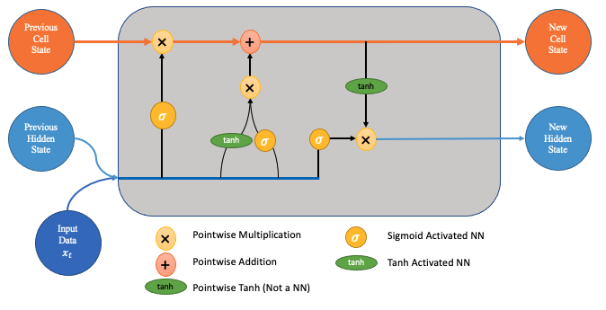
LSTM Architecture
Notes:
Programming is a lot of fun and exciting especially when you’re interested in teaching machines what to do. I’ve seen many people from five-year-olds to ninety-year-olds learn it.
Here, the word it at the end of the sentence refers to programming which is the first word. In between, there are many other words, which could cause an RNN to miss the connection. This happens even though RNNs have some type of memory. However, the LSTMs can resolve this issue.

Slide 49
LSTM Problems
Like RNN, LSTM fails to solve the parallelization problem of RNN, as each hidden state and cell state must be calculated before the next hidden state and cell state are calculated. This also means LSTM takes longer to train and requires more memory.
So far, both RNN and LSTM have described one direction: from left to right. This means we lack the context of words we have not seen yet (mainly the context below) for tasks such as Machine Translation.
This drives the derivation of another variant of RNN and LSTM, which we call bidirectional RNN or bidirectional LSTM. Bidirectional LSTM is often seen in papers and applications.
Notes:
Programming is a lot of fun and exciting especially when you’re interested in teaching machines what to do. I’ve seen many people from five-year-olds to ninety-year-olds learn it.
Here, the word it at the end of the sentence refers to programming which is the first word. In between, there are many other words, which could cause an RNN to miss the connection. This happens even though RNNs have some type of memory. However, the LSTMs can resolve this issue.

Slide 50
BERT model
BERT’s key technical innovation is applying the bidirectional training of Transformer, a popular attention model, to language modelling.
This is in contrast to previous efforts which looked at a text sequence either from left to right or combined left-to-right and right-to-left training.
As opposed to directional models, which read the text input sequentially (left-to-right or right-to-left), the Transformer encoder reads the entire sequence of words at once.
You can train the model first by using the enormous piles of unannotated text on the web (this is known as pre-training).
These general purpose pre-trained models can then be fine-tuned on smaller task-specific datasets, e.g., when working with problems like question answering and sentiment analysis.
Notes:
Programming is a lot of fun and exciting especially when you’re interested in teaching machines what to do. I’ve seen many people from five-year-olds to ninety-year-olds learn it.
Here, the word it at the end of the sentence refers to programming which is the first word. In between, there are many other words, which could cause an RNN to miss the connection. This happens even though RNNs have some type of memory. However, the LSTMs can resolve this issue.

Slide 51
BERT Model Takeaways
Important takeaways:
1. Model size matters, even at huge scale. BERT_large, with 345 million parameters, is the largest model of its kind. It is demonstrably superior on small-scale tasks to BERT_base, which uses the same architecture with “only” 110 million parameters.
2. With enough training data, more training steps == higher accuracy. For instance, on the MNLI task, the BERT_base accuracy improves by 1.0% when trained on 1M steps (128,000 words batch size) compared to 500K steps with the same batch size.
Linguistic causation (SemEval 2020 Task 5) - #1 and #2 was a Bert model and #3 was a CNN
Notes:
Programming is a lot of fun and exciting especially when you’re interested in teaching machines what to do. I’ve seen many people from five-year-olds to ninety-year-olds learn it.
Here, the word it at the end of the sentence refers to programming which is the first word. In between, there are many other words, which could cause an RNN to miss the connection. This happens even though RNNs have some type of memory. However, the LSTMs can resolve this issue.

Slide 52
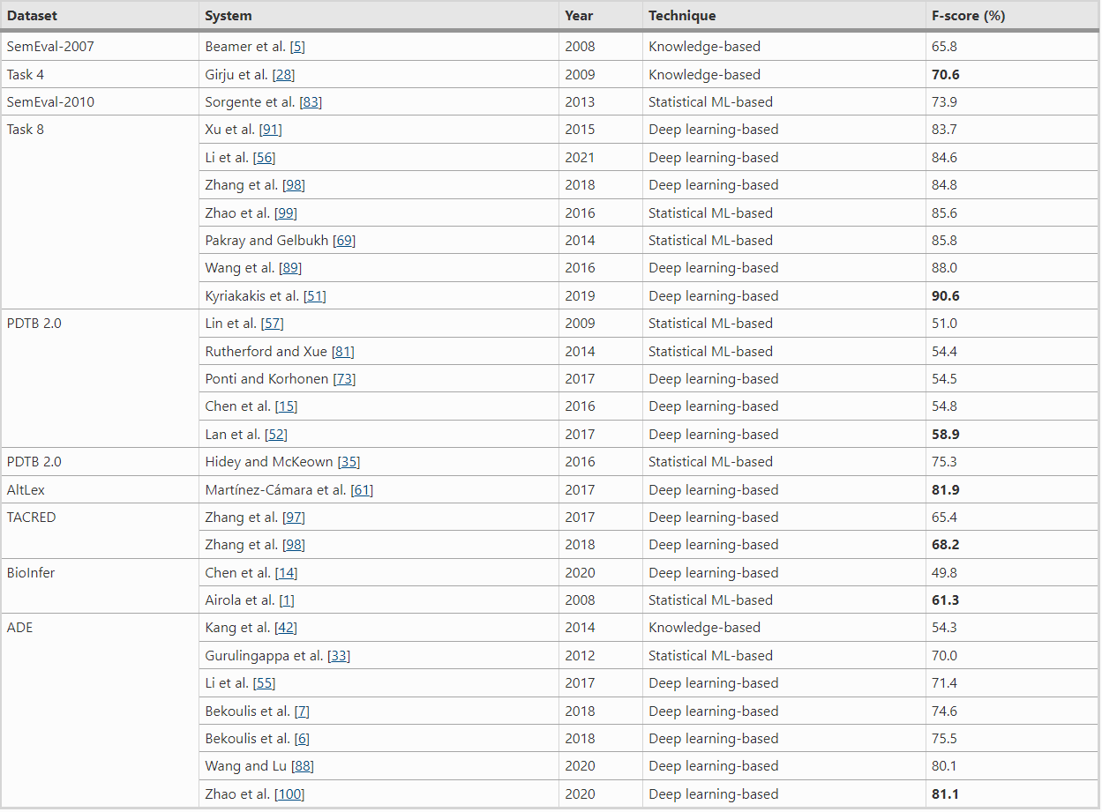
Comparison of Methods

Slide 53
Looking to the Future
Elmo - a type of bidirectional language model
GPT-3 - a language model based in the transformer architecture, pre-trained in a generative, unsupervised manner
Scaling law - focus on increasing the size of neural networks (number of parameters) which have shown to be vastly more important than training data size and even number of iterations
We now have hundreds of billions of parameter models that can be trained with a few thousand data points
The advent of pre-trained model that uses a self-supervising technique was a breakthrough
We can train the model on wikipedia or the web and you mask words from sentences (randomly take out words) and ask the model to figure out what the words are and even while it sound simple it learning a lot of grammar, syntax, and language rules
We then fine-tune this on our domain-specific corpus
Notes:
Programming is a lot of fun and exciting especially when you’re interested in teaching machines what to do. I’ve seen many people from five-year-olds to ninety-year-olds learn it.
Here, the word it at the end of the sentence refers to programming which is the first word. In between, there are many other words, which could cause an RNN to miss the connection. This happens even though RNNs have some type of memory. However, the LSTMs can resolve this issue.

